Slide 1
SMART HOME ENERGY MANAGEMENT SYSTEM
By Kazi Jiya Mukim
Under the guidance of
Dr.T.Premalatha

Slide 2
What is SHEMS
Smart Home
This refers to a home that uses advanced technology such as sensors, IoT devices, automation, and smart appliances.
Energy
This represents the electricity consumption of different appliances and systems in the house—like fans, AC, lights, geysers, fridge, etc.
Management
Management means controlling, monitoring, and optimizing energy usage to reduce wastage and save electricity.
System
A system is a combination of hardware and software working together to achieve a goal.

Slide 3
Existing system and problems related to existing system
Currently, most homes use traditional energy systems or basic smart devices. These systems are not fully automated and do not manage energy efficiently.
Traditional Manual Energy Usage
Smart Devices Without Integration
Basic Metering Systems
Timer-Based Control Systems
Problems in existing system
Lack of Real-Time Monitoring
No Automatic Energy Saving
High Energy Wastage
No Centralized Control
Lack of Predictive Analytics
Poor Remote Accessibility

Slide 4
Proposed System in SHEMS and modules
Authentication and role management
- Allows users to control appliances remotely
- Shows real-time energy consumption
Smart device management
- Smart meters measure energy usage
- Smart switches turn appliances ON/OFF
Real- time energy tracking
- Acts as the “brain” of the system
- Processes signals and controls appliances
- Communicates with mobile apps
Analytics dashboard
- Stores sensor data and usage logs
- Generates reports and usage graphs
Scheduling and Automation
- Creates and stores schedule
- Notify user automatically
Rccomondation system
- Send alerts
Real-time energy monitoring
Automatic appliance control
Smart scheduling based on usage patterns
Renewable energy integration
Alerts and notifications (overload, high usage)
Data analytics for energy-saving

Slide 5
System Configuration
Here we use level 2 technology i.e Standard UG project stack
- Java 17
-Spring boot
- Spring MVC
-HTML5+CSS3
-Bootstrap
-MySQL or PostgreSQL
-Hibernate or spring data JPA
-Maven
-Git and Github
-Postman
- REST APIs

Slide 6
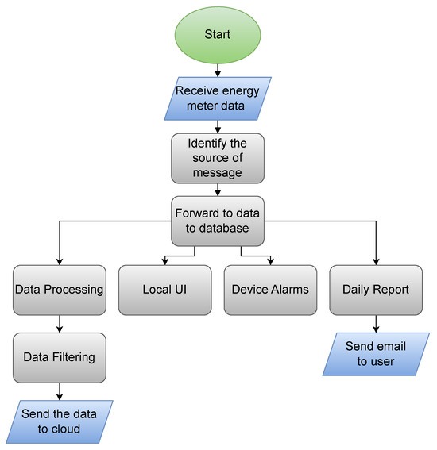
System Architecture

Slide 7
Module 1 : Authentication and Role management
Meaning of the Module
Authentication: This is the process of verifying that a user or device is who or what it claims to be, typically through credentials like a username and password. This acts as the first line of defense against unauthorized access to sensitive energy data or control functions.
Role Management: Following successful authentication, this function determines the specific permissions and access levels granted to the authenticated entity based on a predefined .This ensures users only have access to the resources and controls necessary for their function, following the principle of least privilege.
Activities Performed by the Module
User and Device Registration
Identity Verification
Password validation
Access Control Enforcement

Slide 8
Module 1 : Authentication and Role management
1. User Class
Represents system users and their roles.
Responsibilities / Activities
Store and manage user details:
userId, username, email, password, Validate user data before processing (optional).
Expose methods to update profile or password (if required).
2. UserRepository Class
Handles data access operations for users.
Responsibilities / Activities
Fetch user by username or email during login.
Save new user during registration.
Check if a username/email already exists.
3. AuthService Class
Contains the authentication ,authorization logic.
Responsibilities / Activities
Handle user login (verify credentials).
Hash and compare passwords.
Generate authentication tokens (e.g., JWT).
4. AuthController Class
Acts as the interface between client and backend
Responsibilities / Activities
Accept login and registration requests from UI or mobile app.
Return success or failure responses.
Handle unauthorized access and error messages.

Slide 9
Class diagrams for authentication module
user
userRepository
authService
authController
+userId : int
+userName : string
+password :string
+role :string
+name : string
+address : string
+updateProfile()
+getRole()
+validatelogin(username,password):string
+encryptPassword(password) : string
+generateToken(user) : string
+validateToken(token) : boolean
+findUserByusername(userName) : user
+saveUser (user)
+updateUser(user)
+login(userName,password)
+logout()
+register(user)

Slide 10
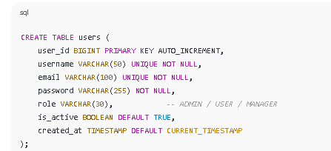
Database schema for module 1
Database schema for user table : as only user class creates table
Classes and its fields :
class user
userId,username,email,password,role, isActive.
Classes and their methods:
Class userRepository
Save(user),findByUsername().
Class authService
Login(),validatePassword(),signUp(),logout(),forgotPassword()
Class authController
signUp(),login(),forgetPassword()

Slide 11
Pseudocode for module 1
Class AuthService
Class AuthService
Function signUp (user Details)
If
- user already exists
Else
- Save user details
- Show “SighUp successfully"
End if
End Function
Function signin (Login Details)
If
- username & pass are correct
- Then generate login token
- allow access
Else
- Show "Invalid Login"
End if
End Function
Function forget pass (email)
If
- email exists Then Send reset link to email
Else
- Show "Email not found"
End if
End Func
End Class
Class User (Stores user data)
Class User
UserID,email,Username,password, role
End Class

Slide 12
Pseudocode for module 1
Class AuthController(receives user request)
  Class AuthController
  Function SignUp(userDetails):
  - Handles incoming signup requests
  - Call authService.SignUp(userDetails)
  - Create object
  End Function
  Function SignIn(loginDetails):
  - Handles incoming signin requests
  - Call authService.SignUp(loginDetails)
  - Create object
  End Function
  Function ForgetPass():
  -Handles forget password requests
  - acts as an entry point for authentication
  End Function
  End Class
Class UserRepository (database access)
Class UserRepository
Function SaveUser(user)
- Store User in DB
End Function
Function FindUsers(Username)
-return User from DB
End Function
End Class

Slide 13
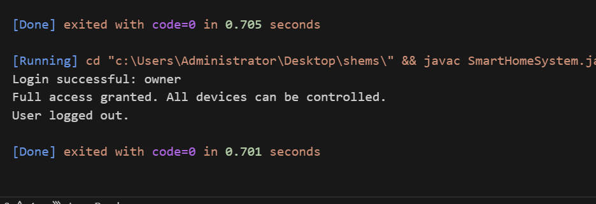
Java Implementation For Module 1

Slide 14
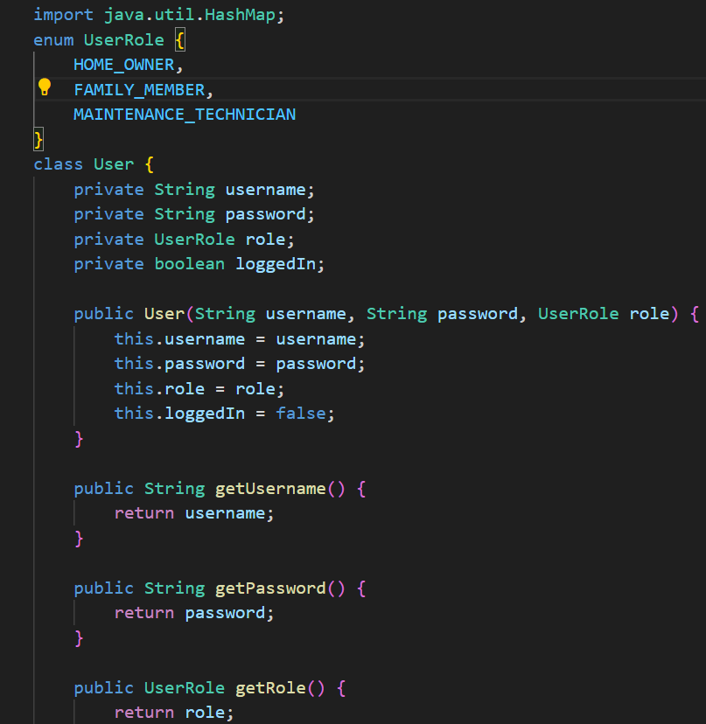
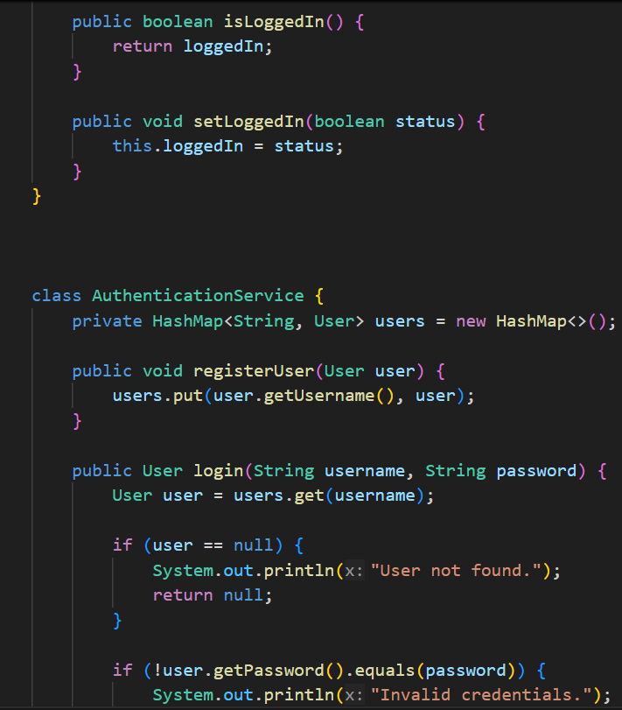

Slide 15
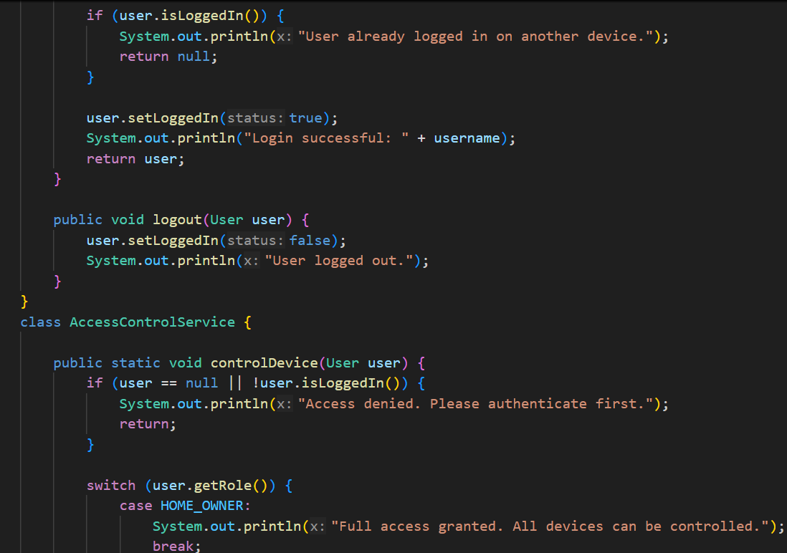
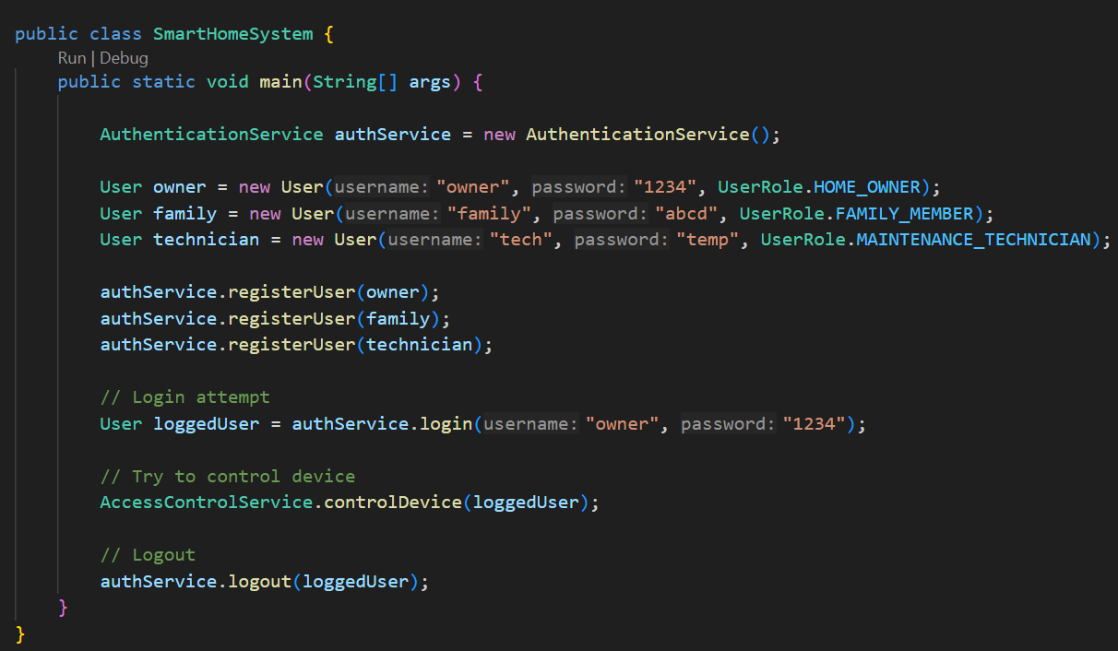

Slide 16
MODULE 2: SMART DEVICE
MANAGEMENT
In a Smart Home Energy Management System (SHEMS), the Smart Device Management Module (also referred to as the Device or Load Management module) is the functional core responsible for the physical execution of energy-saving strategies. It serves as the interface between the central intelligence of the system and the actual electrical loads in the house.
Activities
Real-Time Monitoring and Data Acquisition
  Consumption Tracking
  Status Reporting
Automated and Remote Control
  Switching Operations
  Occupancy-Based Action
  Environmental Adjustments
Load Scheduling and Optimization
  Demand Response Execution
  Priority-Based Management
  Predictive Maintenance
Integration and Safety:
  Renewable Management
  Emergency Interventions
  Configuration and Provisioning

Slide 17
MODULE 2 :SMART DEVICE MANAGEMENT
Device (The Entity/Model)
The Device class is the digital representation of the physical hardware in the home.
Attributes: It stores essential metadata such as a unique DeviceID, manufacturer details (Make/Model), hardware versions, and current operational status (e.g., ON/OFF, Standby).
Data Representation: It holds real-time telemetry data like current power consumption (Watts) and historical energy usage.
Purpose: It acts as a standardized object that other parts of the system can interact with without needing to know the specific brand or technical protocol of the physical hardware.
2. Device Controller
The Device Controller acts as the entry point for external requests, serving as the interface between the user (via mobile app/web) and the backend logic.
Validation: It ensures that requests are authorized and formatted correctly before passing them deeper into the system.
Routing Requests: It receives "Northbound" commands from the user interface, such as "Turn off the AC" .authorized and formatted correctly before passing them deeper into the system.

Slide 18
MODLE 2 :SMART DEVICE MANAGEMENT
3. Device Service (The Business Logic)
The Device Service contains the "intelligence" of the module. It coordinates complex operations and implements the energy management rules.
Optimization Logic: It executes energy-saving algorithms, such as automatically dimming lights based on occupancy or shifting loads to off-peak hours based on dynamic pricing.
Task Coordination: If a user wants to "Optimize Energy," the Service class determines which devices to turn off, which to dim, and which to leave active based on pre-set priorities.
4. Device Repository (The Data Layer)
The Device Repository is responsible for data persistence—connecting the system logic to the database.
Storage & Retrieval: It provides a standard way to save (Create), find (Read), update (Update), and delete (Delete) device information from the central database.
Abstracting the Database: The rest of the module does not need to know if the data is stored in a SQL, NoSQL, or Cloud-based database; the Repository handles these specific database queries

Slide 19
Class diagrams for Smart device management module
Device class
DeviceService class
DeviceController class
DeviceRepository
+deviceid : int
+name : string
+type : string
+powerRating : float
+ownerId : int
+UpdateDeviceInfo()
+CalculatedEstimatedDailyUsage()
+validateOwnership(userid,deviceid)
+computeDeviceConsumption(devideId)
+getDeviceByUser(ownerId)
+addDevice(device)
+updateDevice(device,deviceId)
+deleteDevice(deviceid)
+getDeviceList(ownweId)
+saveDevice(device)
+getDeviceById(id) : device
+updateDevice(device)
+deleteDevice(Id)

Slide 20
Database schema for smart device management
Database schema for device table : as only device class creates table
create table device (
device_id bigint primary key auto_increament,
device_name varchar(100) not null,
device_type varchar(50),
status varchar(20),
location varchar(50),
ip_address varchar(50),
config text,
last_updated timestamp default current_timestamp
);

Slide 21
Pseudocode for module 2
Class DeviceRepository
Class DeviceRepository
Function SaveDevice(device)
-- connect to database
-- Insert device details
-- Close connection
End Function
Function FindDevice(deviceID)
-- Search device using deviceID
- Find device where ID ==deviceID
-- return device
-- Close connection
End Function
End Class
Class Device
Class Device
deviceID ,
deviceName,
powerUsage,
status,
type
Function CreateDevice(id, name,type,power)
-- SET deviceID = id
-- SET deviceName = name
-- SET Device.type = type
-- SET Device.powerUsage = powerUsage
-- SET Device.status = off
End Function
End calss

Slide 22
Pseudocode for module 2
Class DeviceService
Class DeviceService
Variable deviceRepository
Function addDevice (device)
-- deviceRepository.SaveDevice(device)
-- Display "Device added Successfully“
End function
Fun turnOn (deviceId)
-- device = deviceRepository.find device(deviceId)
-- Set device.status = ON
-- display "Device turned ON“
End function
Fun turnOff (deviceId)
-- device = deviceRepository.find device(deviceId)
-- Set device.status = OFF
-- display "Device turned OFF“
End Function
End class
Class DeviceController
Class DeviceController
Variable deviceService
Function addDevice (device)
-- deviceService.addDevice(cdevice)
End function
Function turnOnDevice (device)
-- deviceService.turnOn(deviceId)
End function
Function turnOffDevice (device)
-- deviceService.turnOff(deviceId)
End Function
End Class

Slide 23
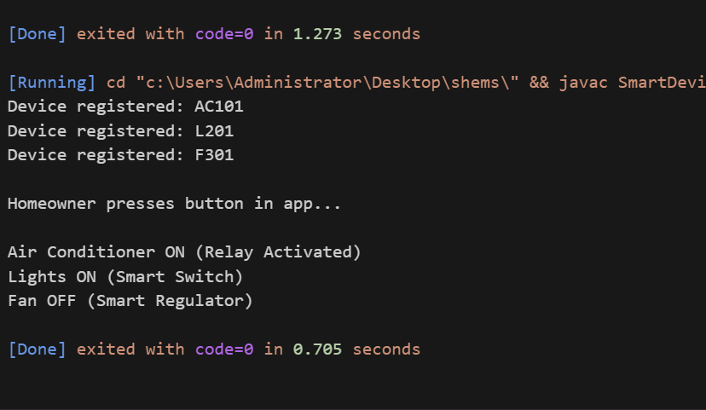
Java Implementation for Module 2

Slide 24
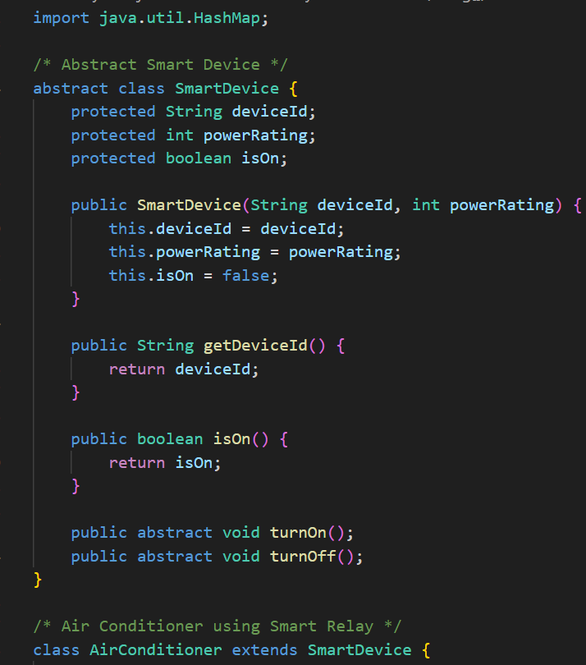
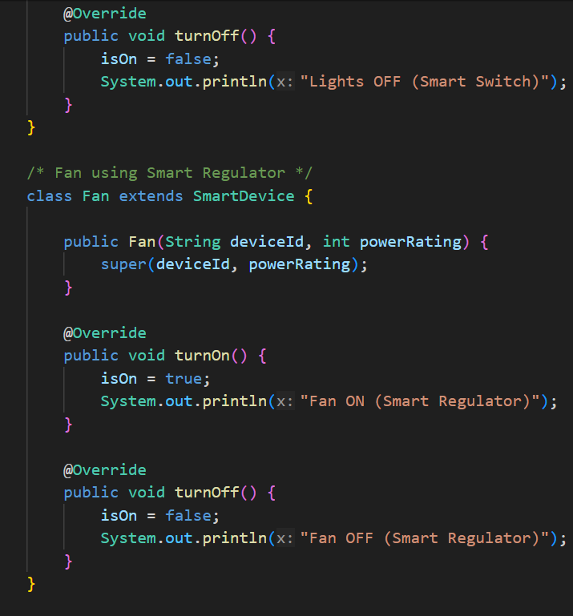
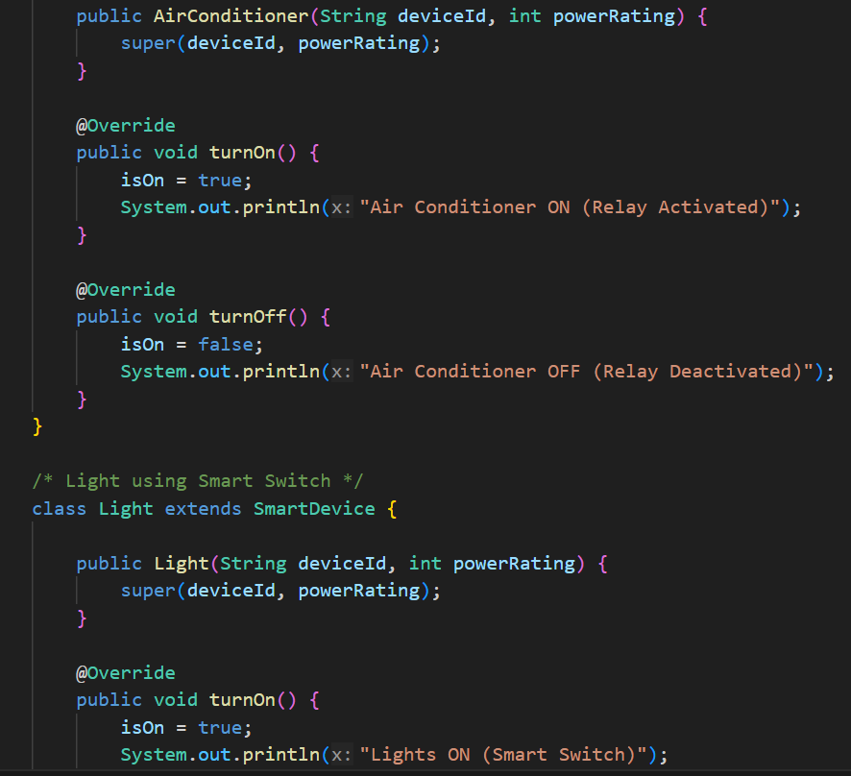

Slide 25
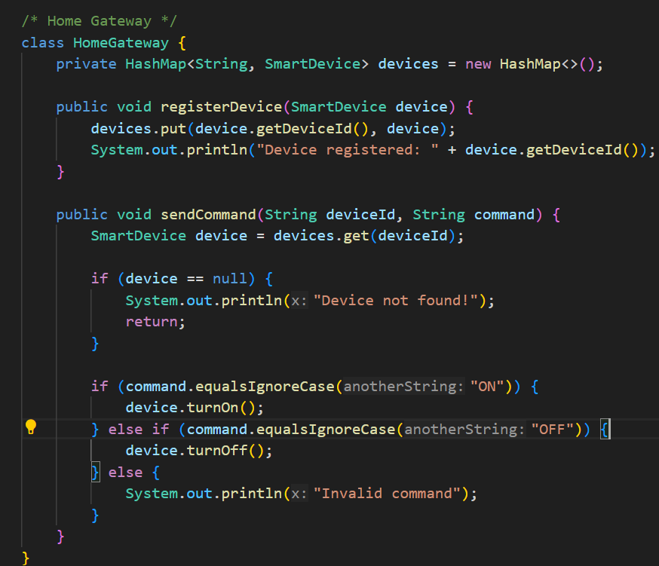
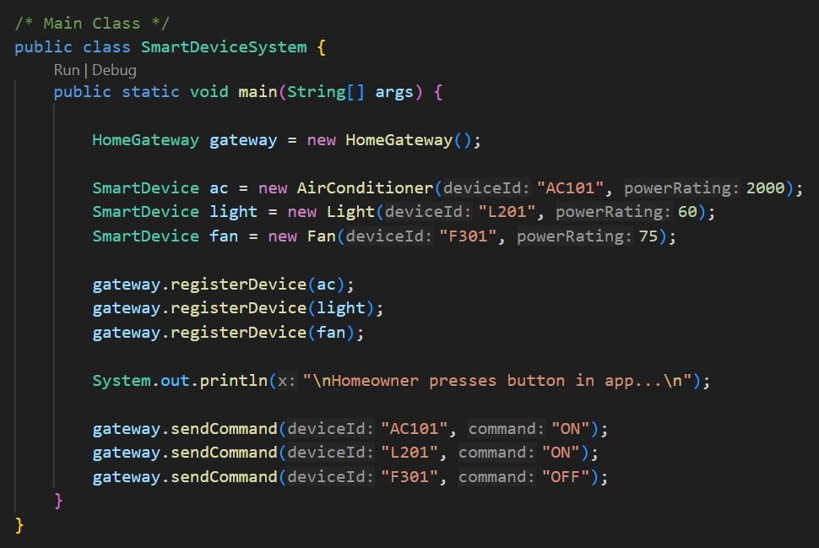

Slide 26
MODLE 3 : Real Time Energy Tracking
A Real-Time Energy Tracking Module in a smart home is the core component of a Smart Home Energy Management System (SHEMS) that uses sensors and IoT to continuously measure, analyze, and display household energy use, identifying waste, enabling remote control, and optimizing consumption for savings via apps or web interfaces, integrating with smart appliances and grids.
Features
Cost Savings: Identifies energy hogs, enables peak-shaving, and optimizes usage based on variable tariffs.
Energy Efficiency: Reduces overall consumption through awareness and automated control.
Convenience: Remote monitoring and smart automation.
Sustainability: Promotes smarter resource use.

Slide 27
Classes in Real-Time Energy Tracking Module
Usageloge Class (Data Entity) :
This class (often a typo for "UsageLog" in various system designs) acts as a Data Transfer Object or an entity that represents a single record of energy activity.
Attributes: It typically stores DeviceID, UserID, StartTime, EndTime, and total PowerConsumed (in kWh).
Activity: It captures a "snapshot" of usage at a specific moment or for a specific duration. This object is what gets passed between the service layer and the database for permanent storage.
EnergyTracking Controller (Entry Point)
The Controller acts as the interface between the external world (the user app or web portal) and the internal system logic.
API Management: It handles incoming requests, such as "Give me the current energy usage" or "Show me last month’s bill".
Routing: It directs user commands (like turning off a high-consumption appliance) to the appropriate service for execution.
Authentication: Ensures that only authorized users can access sensitive consumption data or control smart breakers.

Slide 28
Classes in Real-Time Energy Tracking Module
EnergyTracking Service (Business Logic)
The Service layer is the "brain" where the actual calculations and decision-making occur.
Real-time Processing: It receives raw data (current/voltage) and converts it into readable units like Watts or Kilowatt-hours.
Cost Calculation: It applies "Time of Use" (ToU) tariffs to current usage to estimate live billing amounts.
Alert Generation: If usage exceeds a predefined threshold, this service triggers notifications (SMS/Push) to the user.
Automation Logic: It manages "if-then" rules, such as turning off a heater if it has been running for more than 12 hours.
UsageRepository Class (Data Access)
The Repository acts as a bridge between the EnergyTracking Service and the physical database.
Persistent Storage: It handles the complex SQL or NoSQL queries needed to save UsageCloge objects into the database.
Historical Retrieval: When a user asks for a chart of last year's usage, the Repository fetches that massive dataset from storage and hands it back to the Service.
Data Integrity: It ensures that energy records are accurately saved without duplicates, even if the system loses power or network connectivity briefly.

Slide 29
Class diagram for real time energy tracking module
EnergyUsage class
EnergyTrackingService class
EnergyTrackingController class
UsageRepository class
DeviceRepository
+usageId : int
+deviceId : int
+getLiveUsage(DeviceId)
+getTotalUsage(houseId)
+GetHourlyUsage(deviceId)
getDailyUsage(deviceId)
+stimulateUsage(deviceId) : float
+fetchIdData(deviceId) : float
+calculateTotalUsage(ownerId) : float
+getUsageHistory(deviceId,
period)
+saveDevice(device)
+getDeviceById(id) : device
+updateDevice(device)
+deleteDevice(Id)

Slide 30
Pseudocode for module 3
Class EnergyController
Class EnergyController
function recordEnergy(data)
- energyService.saveEnergy(data)
end function
Function viewEnergy(device_id)
- energyService.getEnergy(device_id)
end function
end Class
Class EnergyUsage
Class EnergyUsage
- deviceId
- energyUsed
- Time
End class

Slide 31
Pseudocode for module 3
Class EnergyService
Class EnergyService
function saveEnergy (data)
- Store energy usage
end function
function getEnergy (device_id)
- return energyData
end function
end Class
Class EnergyRepository
Class EnergyRepository
function save(data)
- Store energy data
end function
function find(device_id)
- return energyData
end function
end Class

Slide 32
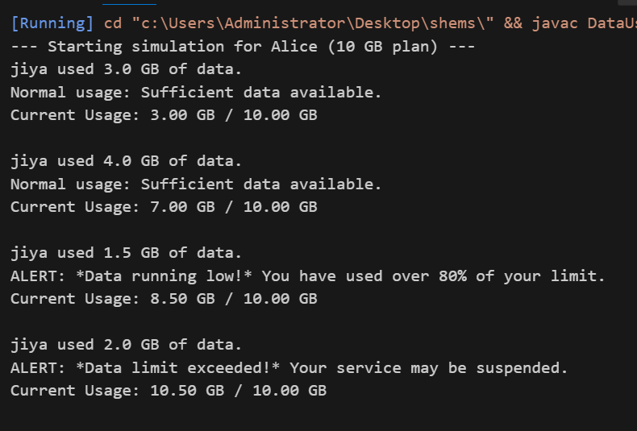
Java Implementation for module 3

Slide 33
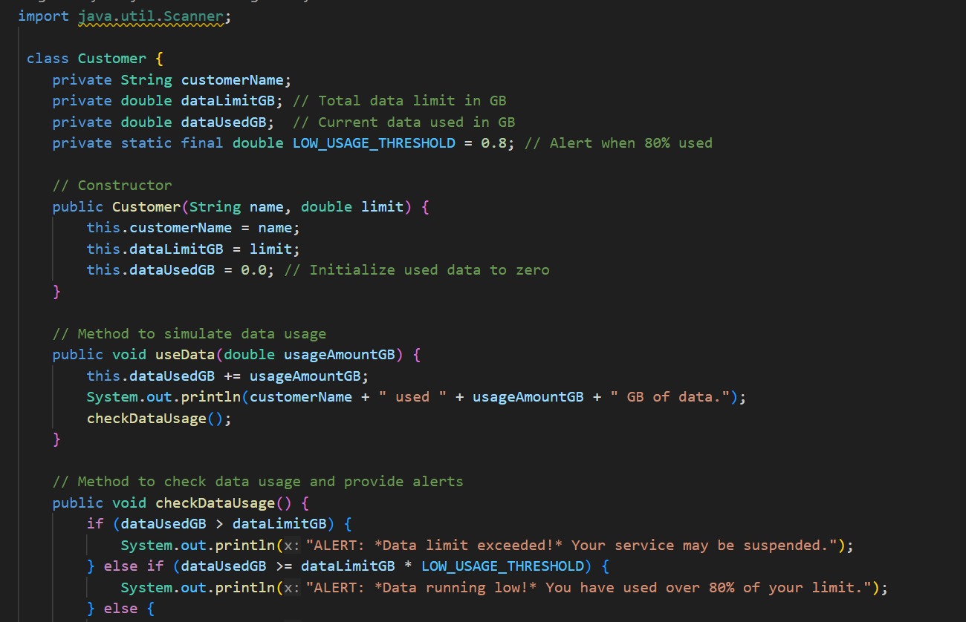
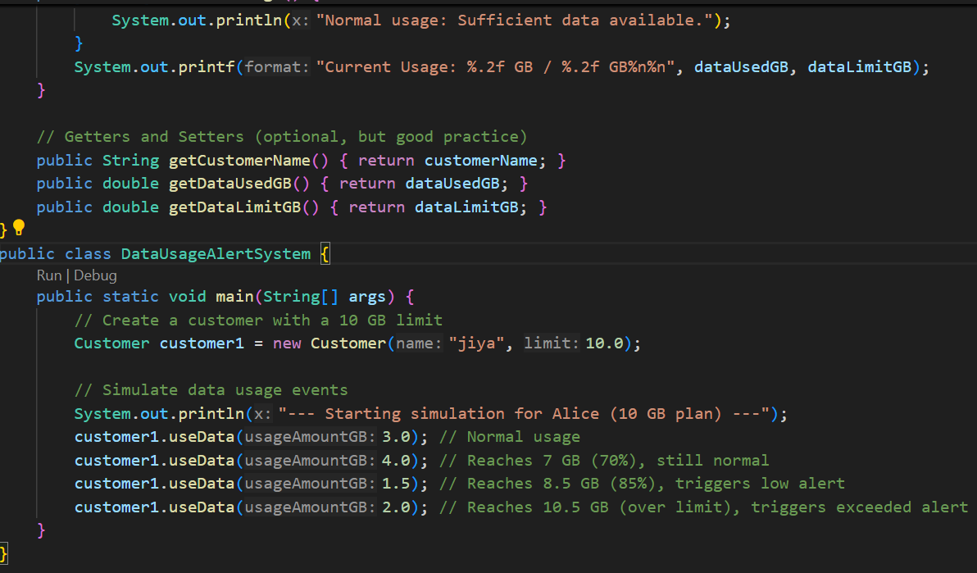

Slide 34


